Slide 1
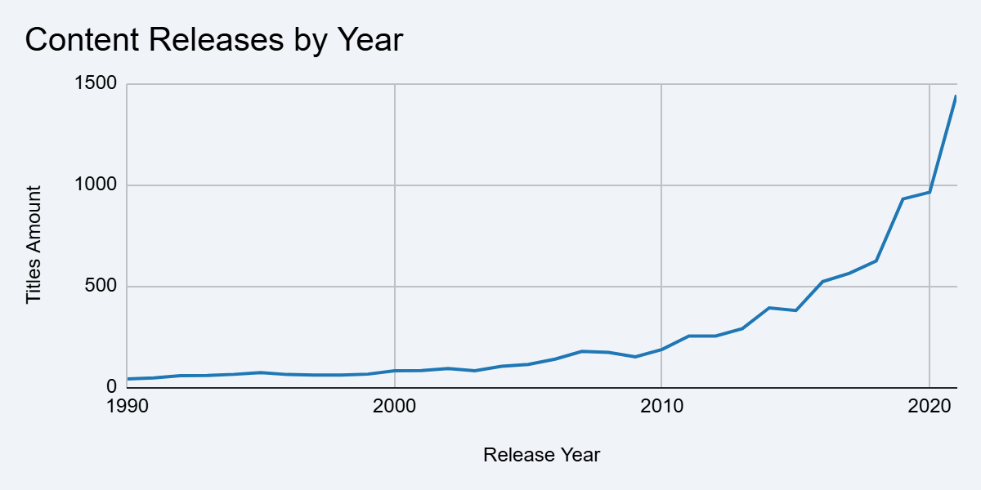
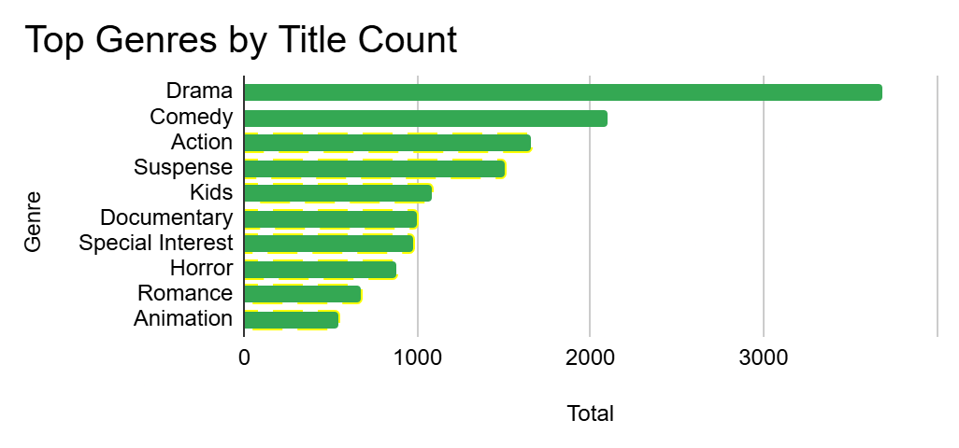
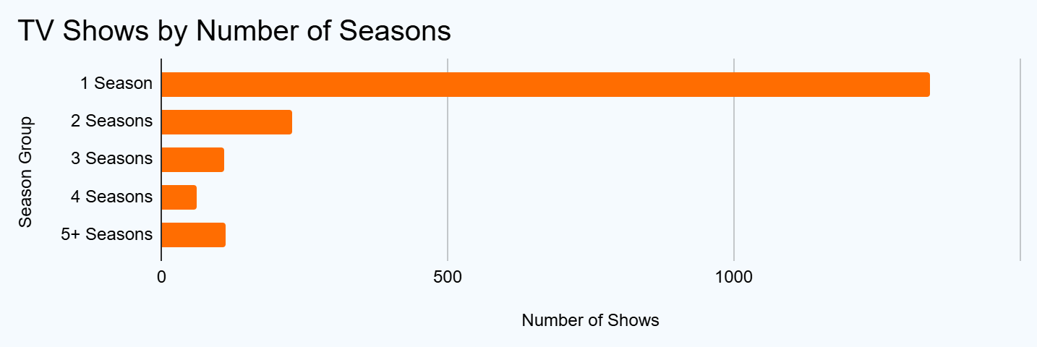
Amazon Prime Content Analysis
Key Trends Across 9,668 Titles

Slide 2
Key Insights & Business Implications
01. Recent Content Concentration
46.73% of titles were released during 2017–2021, with 2021 recording the highest number at 1,442 titles.
Implication: Recent content represents a major portion of the catalog, making release-year segmentation useful for content discovery and catalog analysis.
02. Drama Dominates
Drama is the most frequently appearing genre with 3,687 occurrences, followed by Comedy and Action.
Implication: Genre-based content organization and recommendation could prioritize major genres while maintaining niche categories for targeted audiences.
03. Single-Season Shows Dominate
1,342 of 1,854 TV shows, or 72.38%, have only one season.
Implication: Further analysis using viewing completion, audience engagement, and renewal data could help explain why relatively few shows extend beyond the first season.
Source: Amazon Prime Movies and TV Shows (Kaggle) | Records: 9,668 | Analysis: Google Sheets

